Slide 1

FlipIT Game Model with IBL and comparison with human DAta
Saeefa Rubaiyet Nowmi

Slide 2
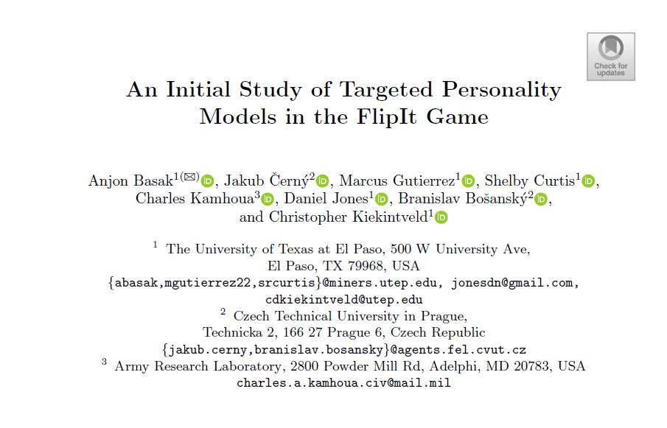
Primary aim is to develop an IBL model of a two player FlipIT Game and compare the results with Human attacker
This paper uses EFG (Extensive - Form Games) – a Game Theory Model

Slide 3
The Game
Two players
6 nodes
Node A(10/8), Node B(10/2), Node C(4/2), Node D(4/8), Node E(10/5), Node F(0/0).
The game has 5 rounds.
6 trials in every round. Total 30 trials
Human paritcipants were 152. So, I also simulated the model to have 152 runs

Slide 4
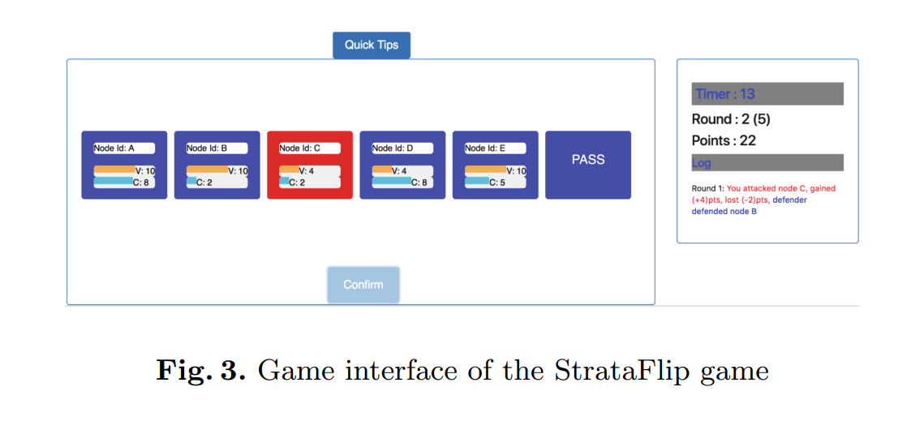

Slide 5
Task description
Tasks are divided into three steps :
1.Developing IBL Model with one agent (full information)
2. Developing IBL Model with two agent (full information)
3.Developing IBL Model with two agent (partial information)
4. Analyze data and compare both the models with human attackers

Slide 6
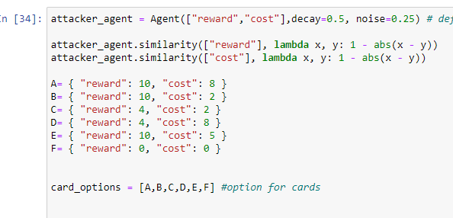
Created one agent model with two features –
-Reward
-Cost
Used Linear Similarity Function

Slide 7
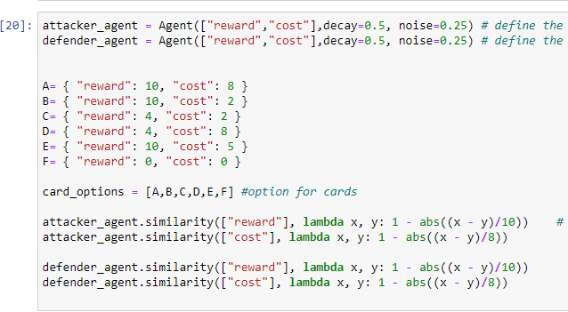
Created two agent model with two features –
-Reward
-Cost
Used Linear Similarity Function

Slide 8
Final results
Comparison of choosing nodes
Comparison of winning ratios
Comparison of scores
Comparison of performance (the line graphs)

Slide 9
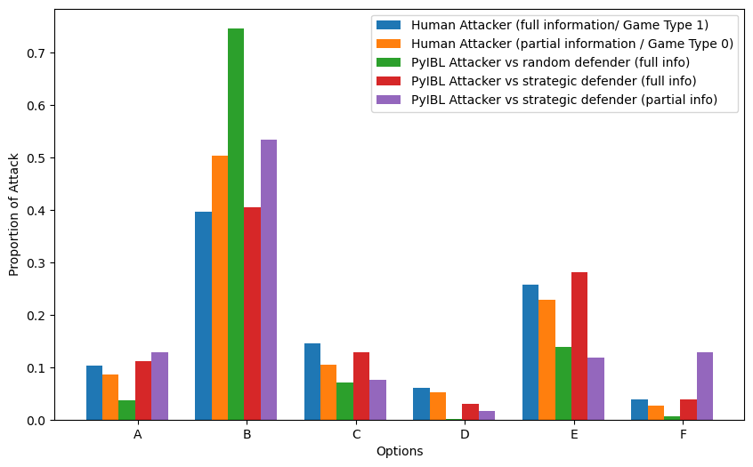

Slide 10
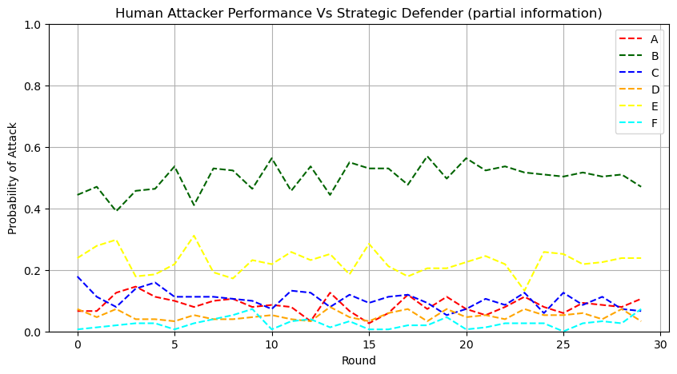
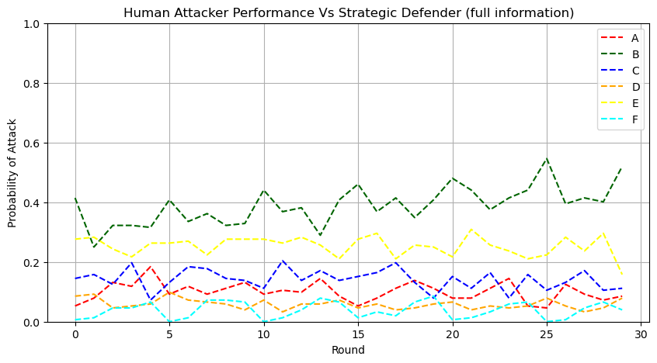

Slide 11
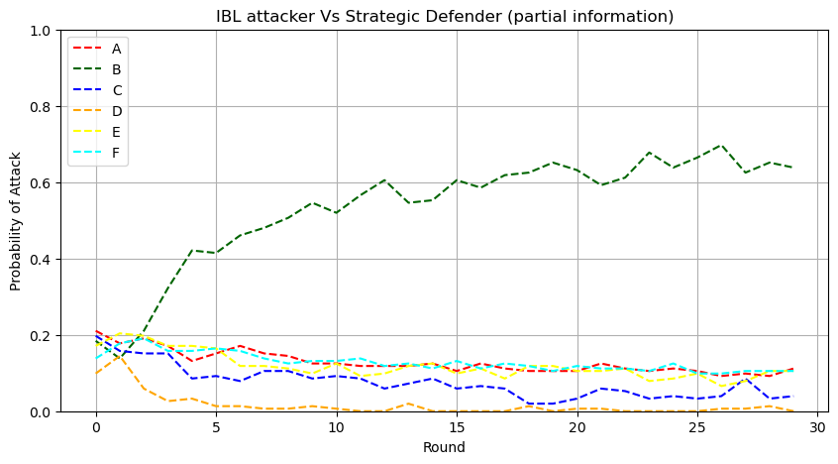
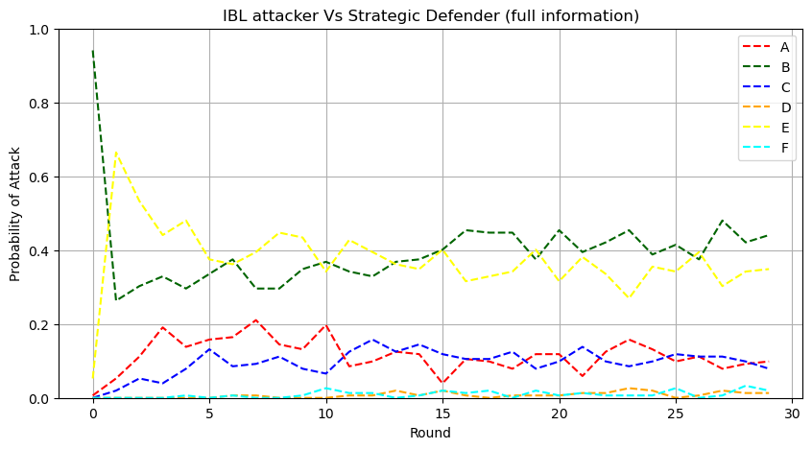

Slide 12
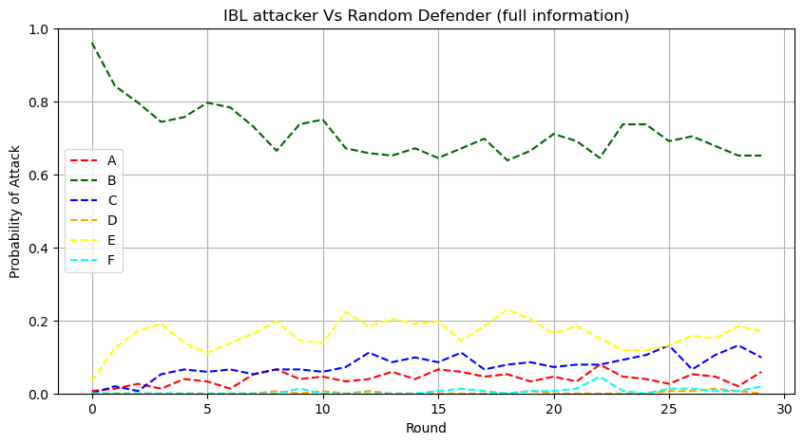

Slide 13
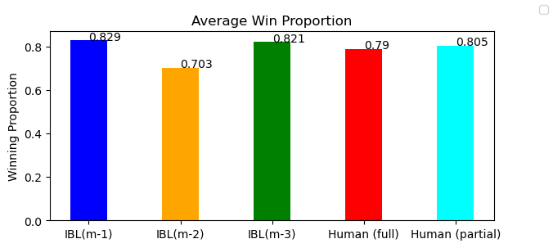

Slide 14
Scopes to Improve
1. Analyze the human data against random defender
2. Compare with the Game Theory Model as well
3.Analyse and match human data for different personality types

Slide 15
Supporting Literature
1. Abbasi, Y.D., Short, M., Sinha, A., Sintov, N., Zhang, C., Tambe, M.: Human adversaries in opportunistic crime security games: evaluating competing bounded rationality models. In: Proceedings of the Third Annual Conference on Advances in Cognitive Systems ACS, p. 2 (2015)
2. Durkota, K., Lis´y, V., Kiekintveld, C., Hor´ak, K., Boˇsansk´y, B., Pevn´y, T.: Optimal strategies for detecting data exfiltration by internal and external attackers. In: Rass, S., Kiekintveld, C., Fang, F., Schauer, S. (eds.) GameSec 2017. LNCS, vol. 10575, pp. 171–192. Springer, Cham (2017). https://doi.org/10.1007/978-3-319- 68711-7 10
3. Reitter, D., Grossklags, J., Nochenson, A.: Risk-seeking in a continuous game of timing. In: Proceedings of the 13th International Conference on CognitiveModeling (ICCM), pp. 397–403 (2013)
4. Kahneman, D., Tversky, A.: Prospect theory: an analysis of decision under risk. In: Handbook of the Fundamentals of Financial Decision Making: Part I, pp. 99–127. World Scientific (2013)

Slide 16
Thank You!
Any Question?

